Slide 1


The market basket analysis of Nexus
Course: Capstone: create value from open data
Student: Nino požar
13th March 2019

Slide 2
Executive summary
Task
Data
Analysis
Conclusions
Identify items that are frequently bought together
Deliver value to Nexus by improving sales in terms of more items bought per purchase
Dataset contains all relevant information in terms of date and time of purchase, items bought, customer ID, price of item, country of customer, invoice ID and quantity bought
Market basket analysis was performed using apriori algorithm
Market basket analysis provides us information on what items are most frequently bought together
With successful market basket analysis, we found particularly interesting conclusions about the data
We provided recommendations on which items should be connected or packaged together to improve sales
We made basic recommendation of implementation of recommender system for Nexus

Slide 3




Nexus is a UK-based and registered non-store online retail. The company mainly sells unique all-occasion gifts.
The management of company is not satisfied with current amount of sales and believe they can improve them by using analytics approach.
The company wants to improve it’s sales and earnings by introducing recommender system that will group similar items together.
By introducing the system, Nexus wants to gain much needed competitive advantage.
At average, if online retail company successfully implements market-basket-based recommender systems, sales improve about 15%, with ROI at average of 112%.
THIS ISSUE IS EXTREMELY IMPORTANT FOR ALL ONLINE RETAIL COMPANIES
2.5 MIL. ₤ SALES INCOME
112% ROI
15% MORE SALES

Slide 4
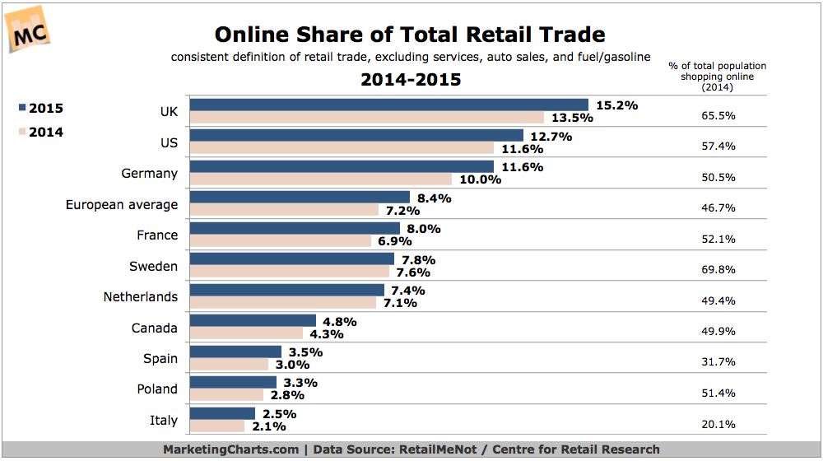
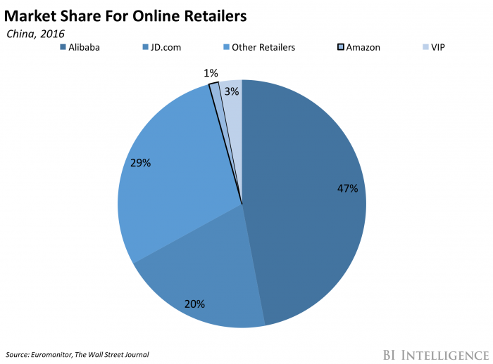
Market situation
The number of online share of total retail is growing, specially in the UK where in 2015 15.2% of retail happens online.
„Big guys” on market are still Alibaba, JD and Amazon.
Nexus must implement analytics to compete with top retailers.
Key to improve sales is to become customer centric, and by applying analytics, Nexus can achieve that.
Available at: https://www.marketingcharts.com/industries/retail-and-e-commerce-53439
Available at: https://www.businessinsider.com/amazon-is-struggling-to-find-its-place-china-2017-8

Slide 5
Tasks and vision of analysis
Raw variables are InvoiceNo, StockCode, Description, Quantity, InvoiceDate, UnitPrice, Unit price, CustomerID, Country.
To complete analysis we will extract day, month, year and day-of-the-week values from InvoiceDate.
We will remove missing values.
We will use aggregate functions to group sales by day, weekday, customer, country and item; and look for it’s summaries such as average earnings, sales, etc.
We will interpret the processed data to extract meaningful information such as IDs of items frequently bought together to drastically improve our business.

Slide 6
Data and analysis framework
GETTING DATA
Data is available at : UCI Machine Learning Repository
RAW VARIABLES:
InvoiceNo: Invoice number. Nominal, a 6-digit integral number uniquely assigned to each transaction. If this code starts with letter 'c', it indicates a cancellation. StockCode: Product (item) code. Nominal, a 5-digit integral number uniquely assigned to each distinct product. Description: Product (item) name. Nominal. Quantity: The quantities of each product (item) per transaction. Numeric. InvoiceDate: Invice Date and time. Numeric, the day and time when each transaction was generated. UnitPrice: Unit price. Numeric, Product price per unit in sterling. CustomerID: Customer number. Nominal, a 5-digit integral number uniquely assigned to each customer. Country: Country name. Nominal, the name of the country where each customer resides.
DATA PREPROCESSING:
Data was preprocessed by removing missing values, factorizing strings and decomposing date into day, month and year. More preprocessing was done based on analysis we were doing.
EXPLORATORY DATA ANALYSIS:
In EDA we analyzed how sales change over time, looking for patterns, we analyzed where sales come from and looked which are most profitable and most sold items.
MARKET BASKET ANALYSIS:
We completed MBA using apriori algorithm and observed which items are most frequently bought together and what are customer’s association rules.
REPORTING AND CONCLUSIONS:
Based on the analyses we have completed, we provided Nexus with informative and concise recommendations on how to implement their own recommender system that groups items frequently brought together.

Slide 7





Market basket analysis
- MBA is one of the key techniques used by large retailers to uncover associations between items.
- Association rules are widely used to analyze retail basket or transaction data, and are intended to identify strong rules discovered in transaction data using measures of interestingness, based on the concept of strong rules.
- For a online retail company such as Nexus, this kind of analysis is of utmost importance. Companies that understand it’s customers and their online behavior have big competitive advantage.
- Online retail companies such as Craigslist, E-Bay and Amazon are great examples of companies that utilized MBA to become leaders in the field.
- MBA can be conducted in R using apriori algorithm.
- Both stakeholders, the company and customer gain value from the implementation of MBA findings.
Company value
Sales
Profit
Customer satisfaction
Loyalty
Company
Customers

Slide 8
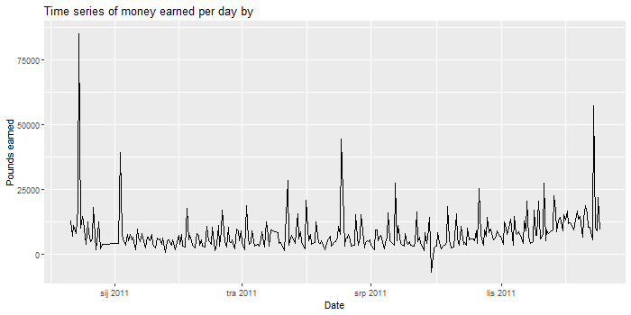
Overall sales of Nexus
As mentioned, management is not satisfied with current sales.
CONCLUSIONS ABOUT DAILY SALES
Sales are pretty much static over the year
There are clear patterns of increased sales, specially around hollidays in December
There is lower amount of sales on weekends, which is expected since Nexus does not accept orders on Saturdays or Sunday mornings
THE GOAL IS TO IMPROVE SALES AND GAIN PROFIT!
Table 1. Amount of sales par day of the week
Monday | Tuesday | Wednesday | Thursday | Friday | Saturday | Sunday
94933 | 101516 | 94246 | 103550 | 81835 | 0 | 64375

